Slide 1
Image normalization for ML processing
by @pospanet

Slide 2
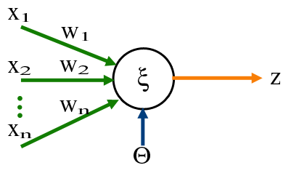
Perceptron
X … input
W … weight
θ … Bias
Z … output
https://cs.wikipedia.org/wiki/Perceptron

Slide 3
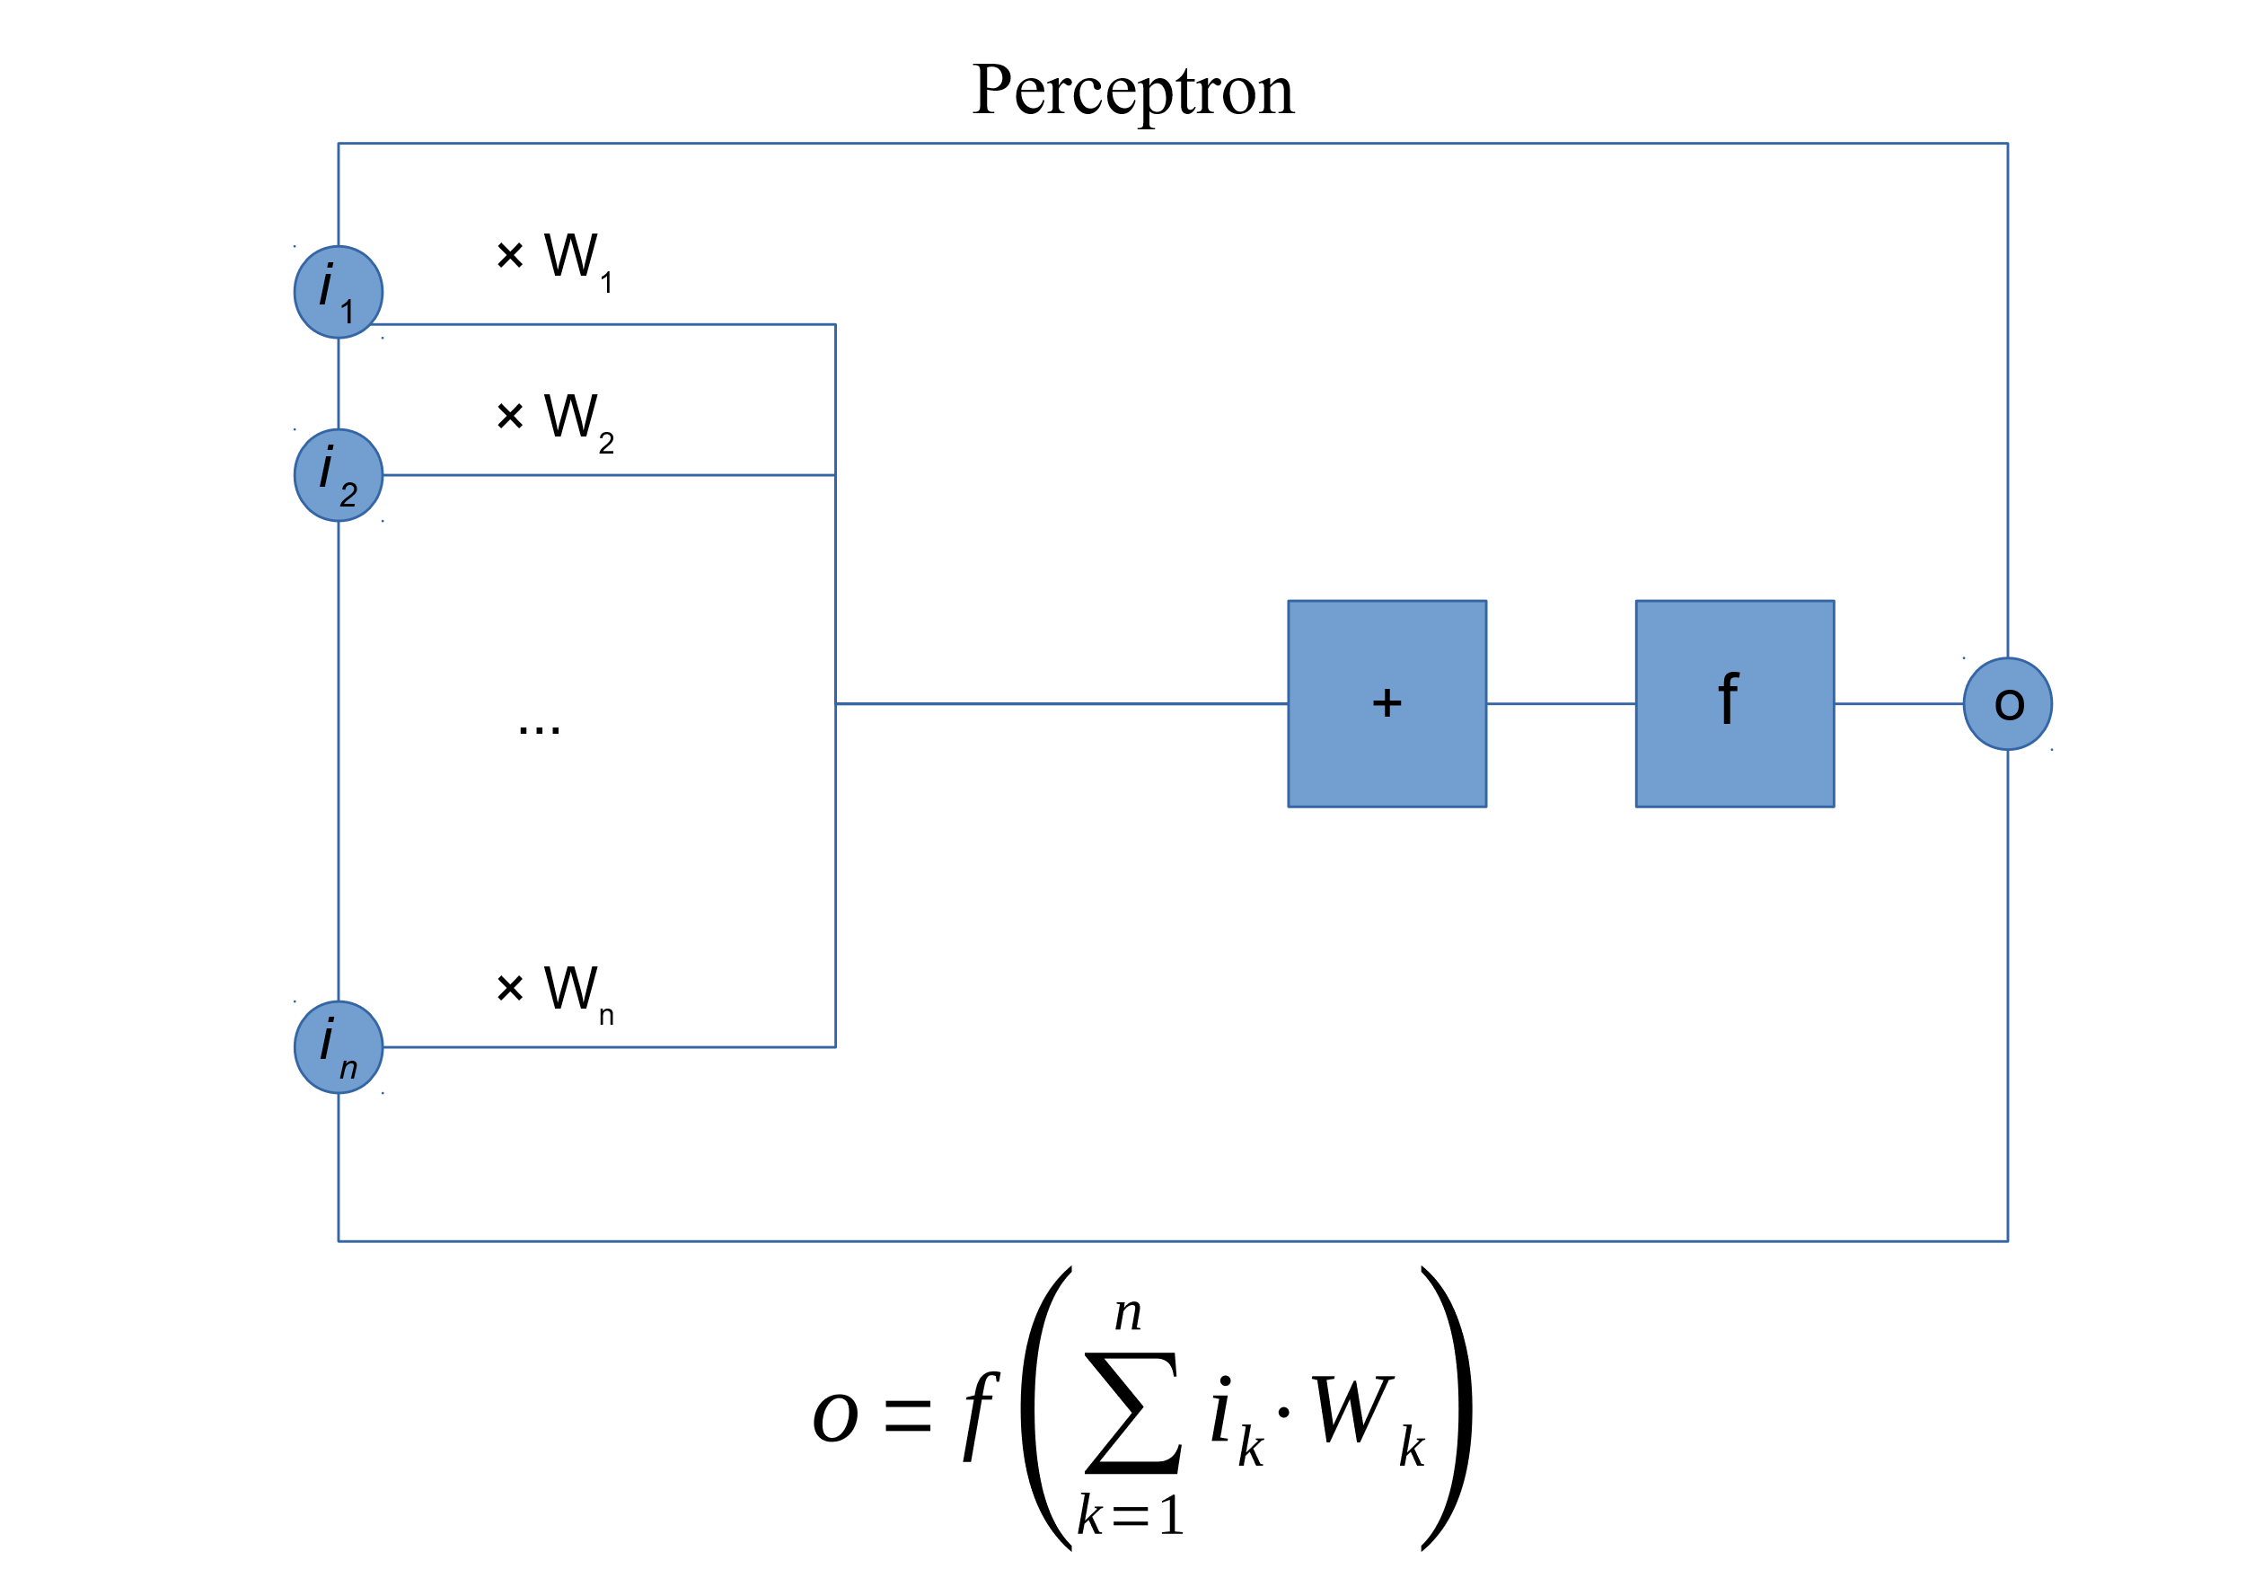
Perceptron
X … input
W … weight
f … activation function
O … output

Slide 4
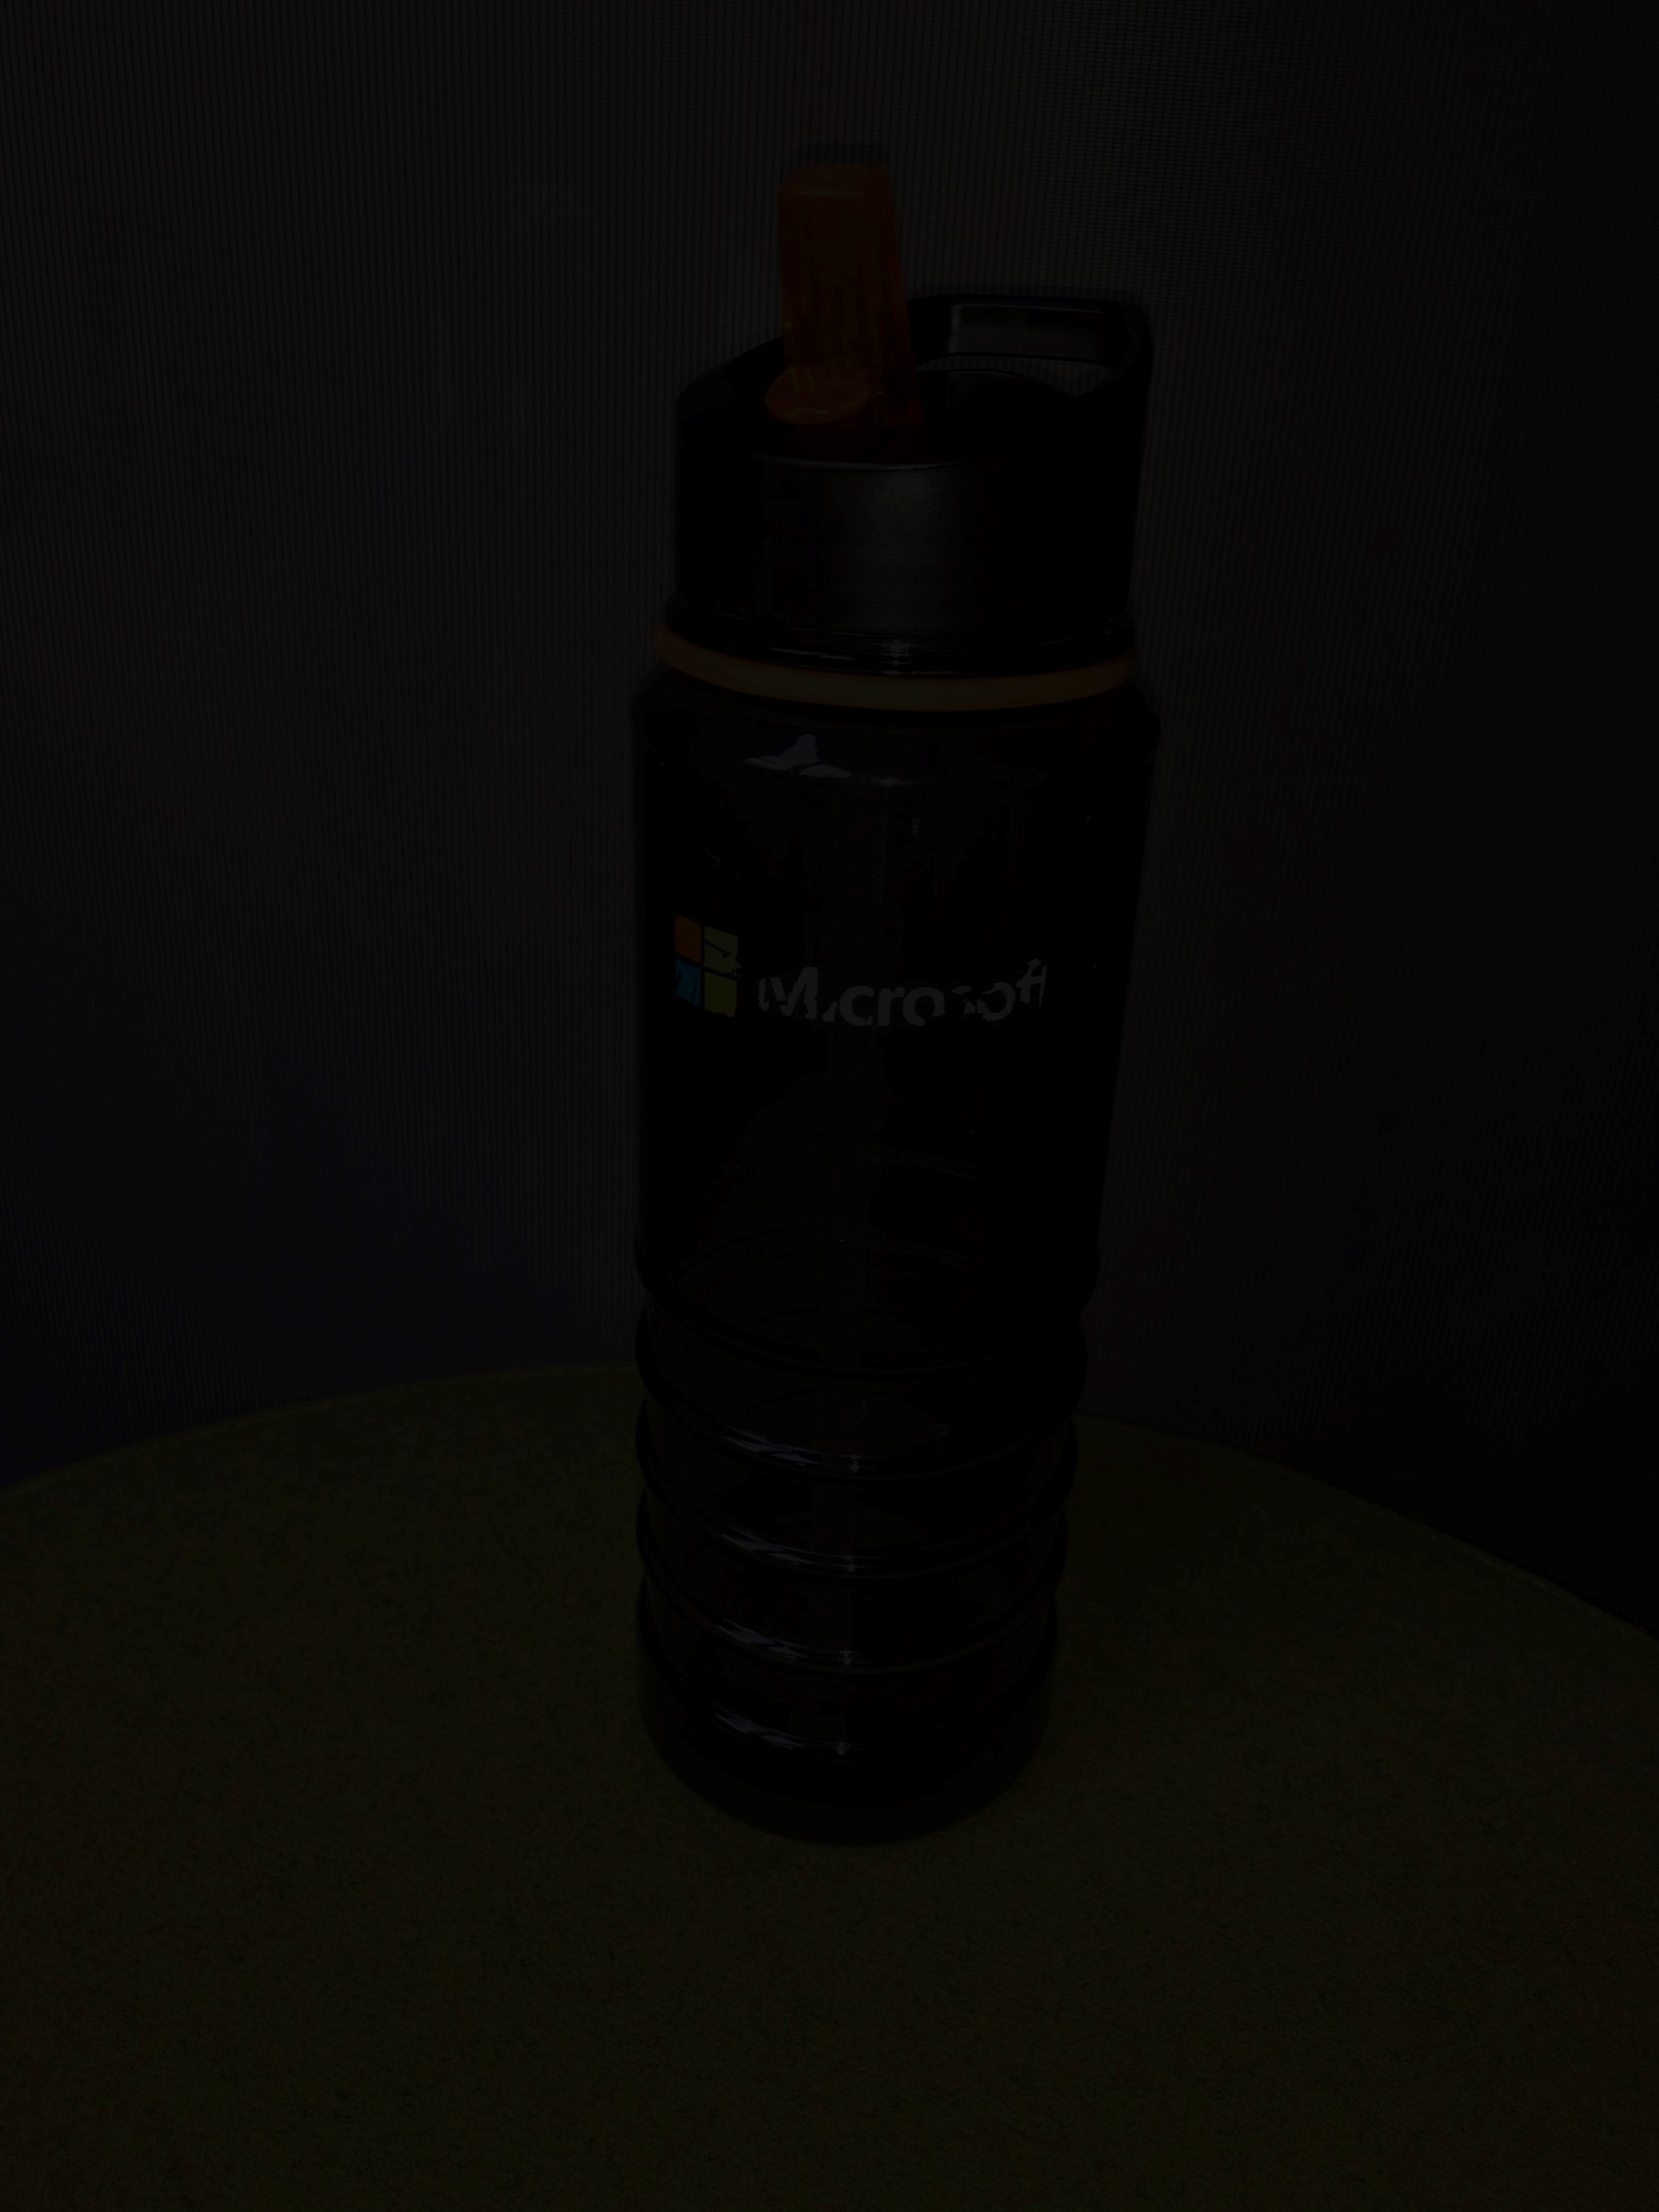
Why image normalization
Data “distance” is to small not using whole spectrum
Can you guess what is on the picture on the right?
Noisy information
Notes:
Distance, Value distribution > it should be comparable

Slide 5
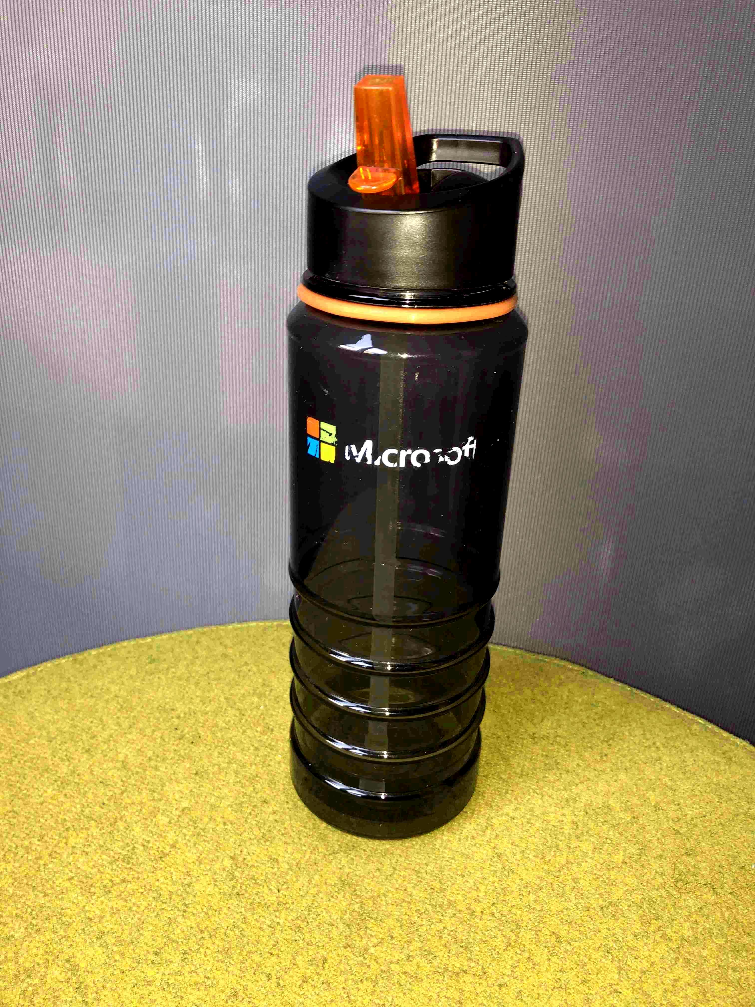
Original image
Normalized (for humans)

Slide 6
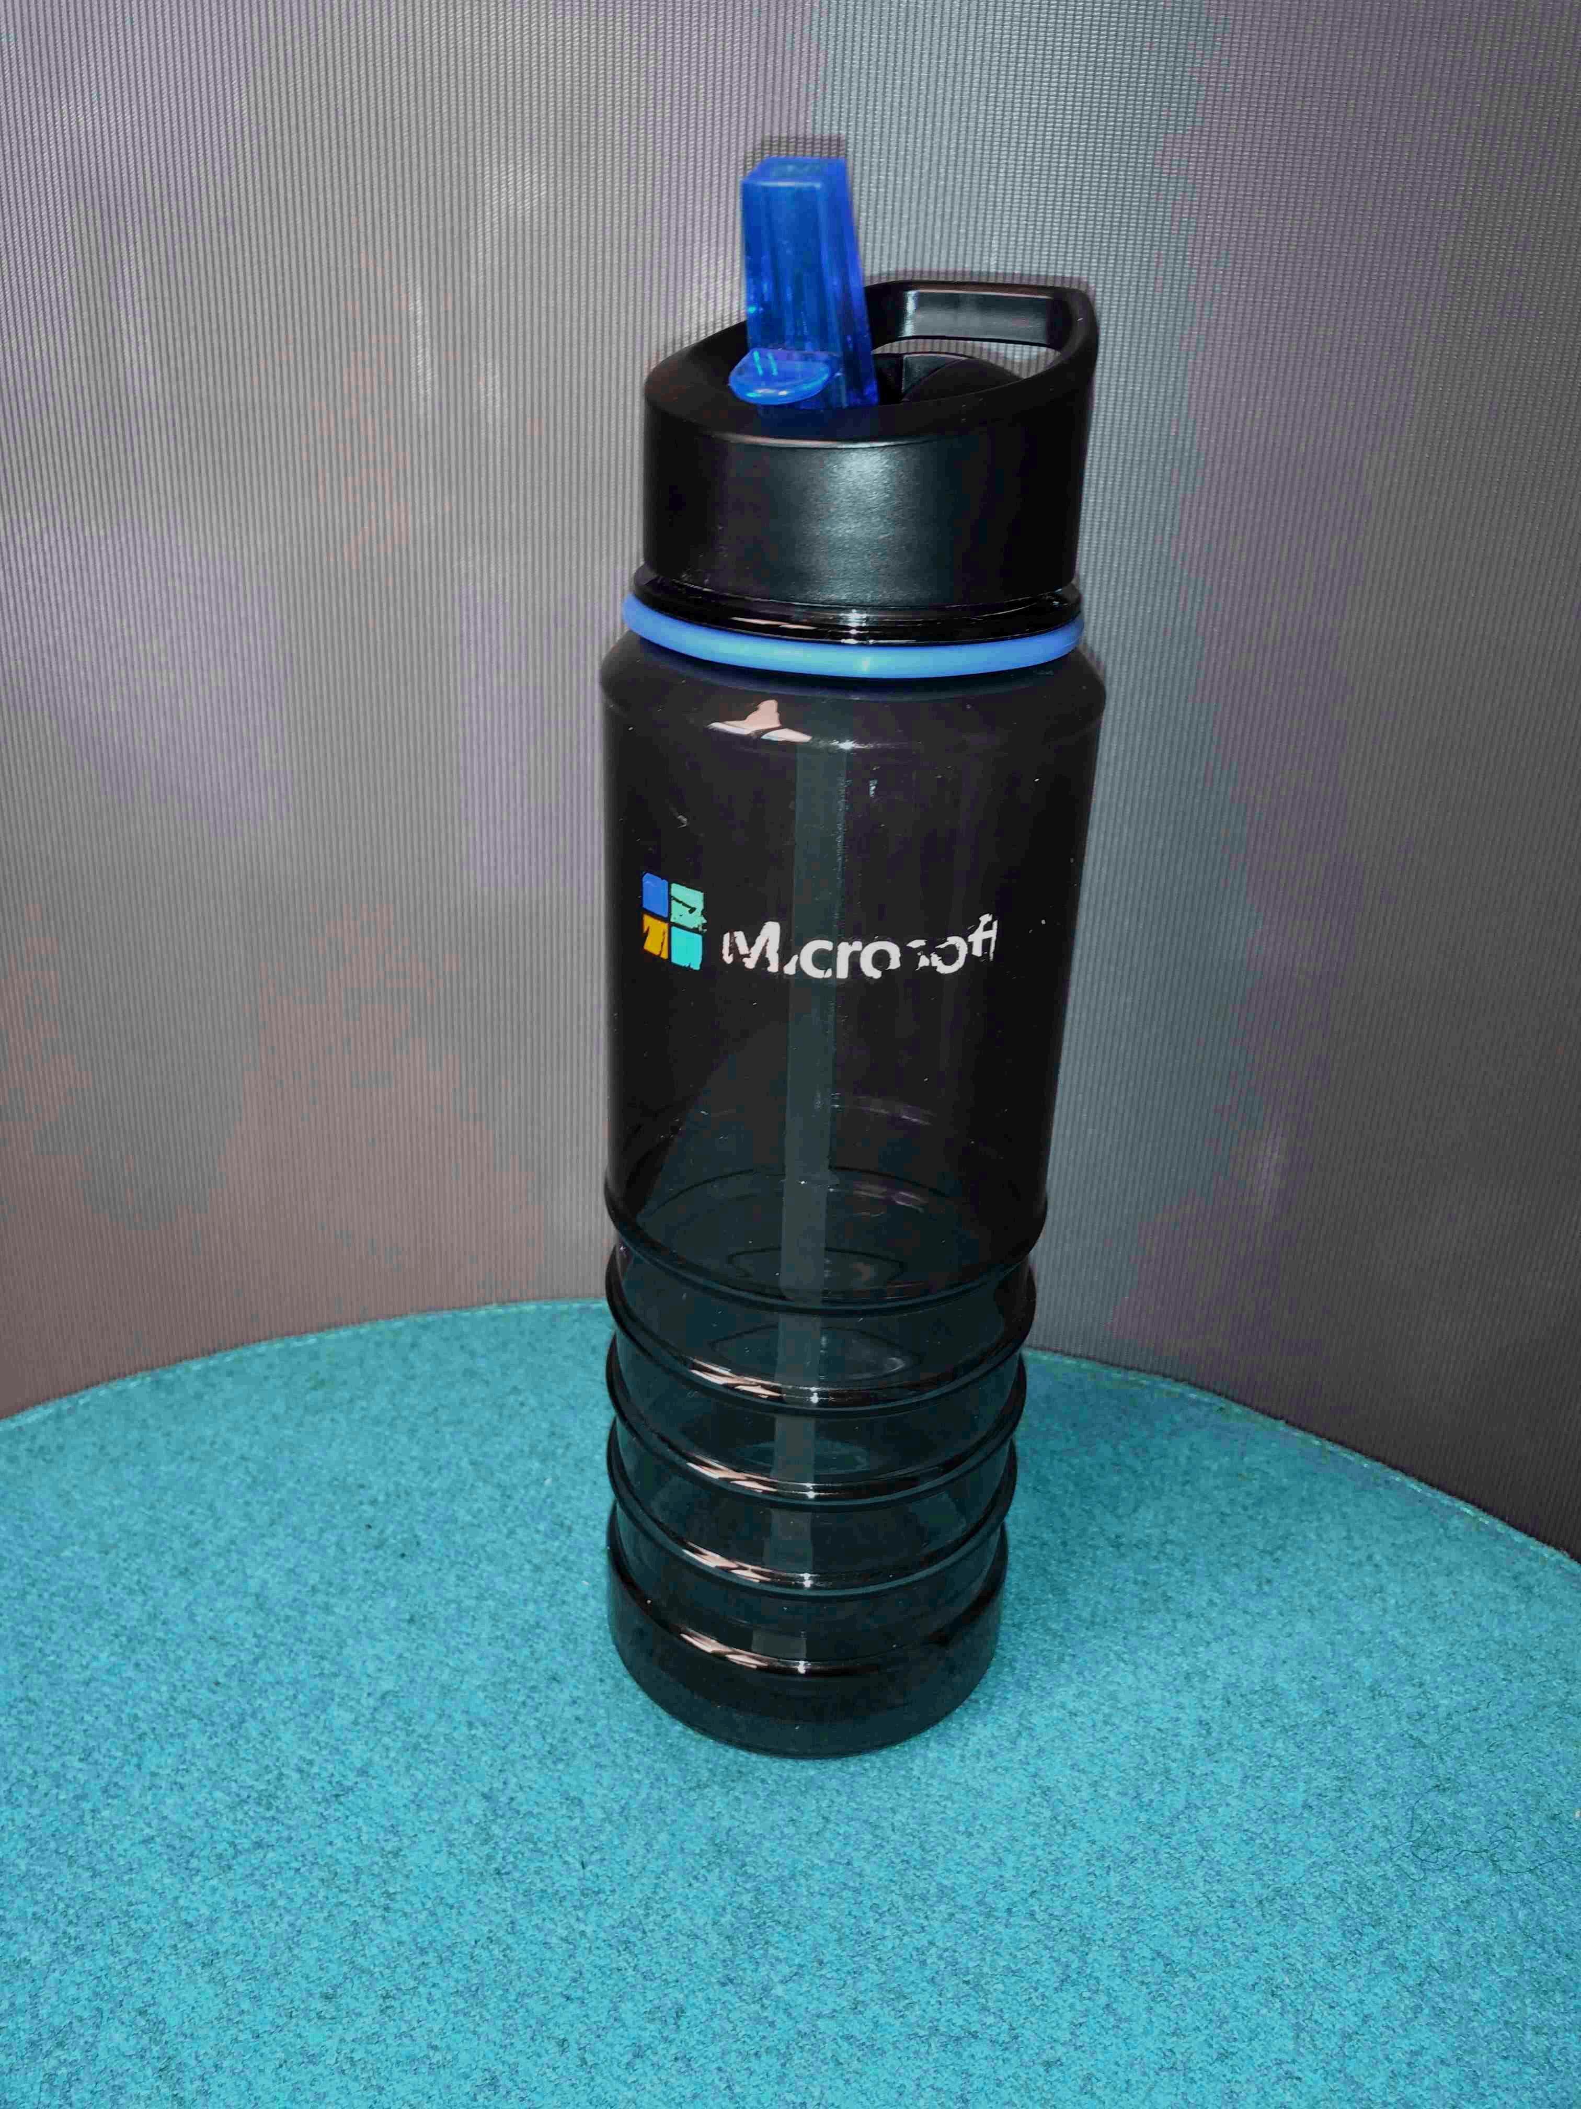
Original image
Normalized image (for computer vision)

Slide 7
Python demo
By Jupyter notebook

